Slide 1
Chapter 6
Timing Operations

Slide 2
Table of Contents
Introduction
Microcontroller Architecture
Software Development Platforms
Digital Input and Output
Interrupts and Power Management
Timing Operations
Conversion Between Analog and Digital Values
Digital Communication
Memory Operations
Real-time Operating Systems
LCD, Touch Screen, and Graphical User Interface Formation
Introduction to Digital Signal Processing
Introduction to Digital Control
Introduction to Digital Image Processing
Advanced Topics

Slide 3
LAYOUT
Clock Signals in Embedded Systems
  What is a Clock Signal?
  Oscillator as the Clock Signal Source
  Managing Clocks in the STM32F4 Microcontroller
Timers in Embedded Systems
  What is a Timer?
  Introducing Timers in the STM32F4 Microcontroller
  Base Timers in the STM32F4 Microcontroller
  System Timer in the STM32F4 Microcontroller
  Watchdog Timers in the STM32F4 Microcontroller
  Real-time Clock in the STM32F4 Microcontroller
  Advanced Base Timer Operations in the STM32F4 Microcontroller
Timer Setup in the STM32F4 Microcontroller
Timer Usage in the STM32F4 Microcontroller

Slide 4
Introduction
Time based operations are crucial in embedded applications.
They can be used to execute specific commands in dedicated time instants.
Time difference between the occurrence of two or more operations can be calculated via time based operations.
There are specific modules in embedded systems for time based operations as:
  oscillators
  clocks
  timers

Slide 5
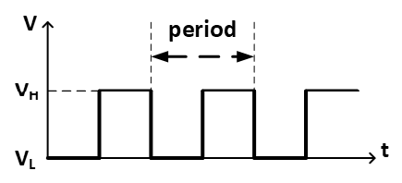
Clock Signals in Embedded Systems
What is a Clock Signal?
Clock is basically a periodic square signal oscillating between high and low states with predefined frequency (specifically called clock frequency).
A sample clock signal.

Slide 6
Clock Signals in Embedded Systems
Oscillator as the Clock Signal Source
An oscillator is an electronic circuit producing a periodic square wave which is the clock signal for our case. Therefore, an embedded system that needs a clock signal should have an oscillator or oscillators.
An oscillator can be described by its two properties
  accuracy: indicates how precise the desired clock signal can be generated by the oscillator in terms of its frequency.
  response time: indicates the time needed for the oscillator to stabilize. Hence, it can generate the clock signal with the desired frequency.
There are mainly two oscillator types as
  resistive-capacitive (RC)
  crystal.

Slide 7
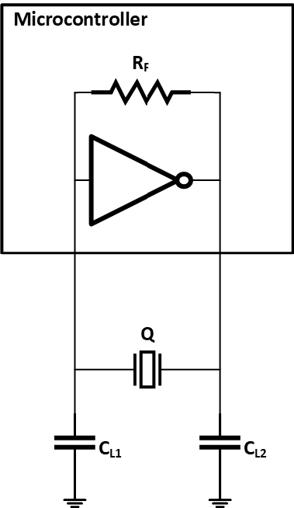
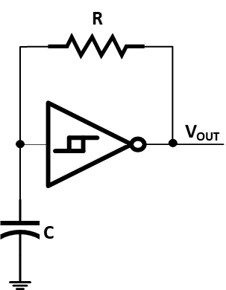
Clock Signals in Embedded Systems
  Basic Schmitt trigger RC oscillator.
  A crystal oscillator.

Slide 8
Clock Signals in Embedded Systems
  Managing Clocks in the STM32F4 Microcontroller
  The STM32F4 microcontroller has several clocks and clock signal sources.
  When more than one time based operation is performed within the microcontroller, clocks working with different frequency may be needed.

Slide 9
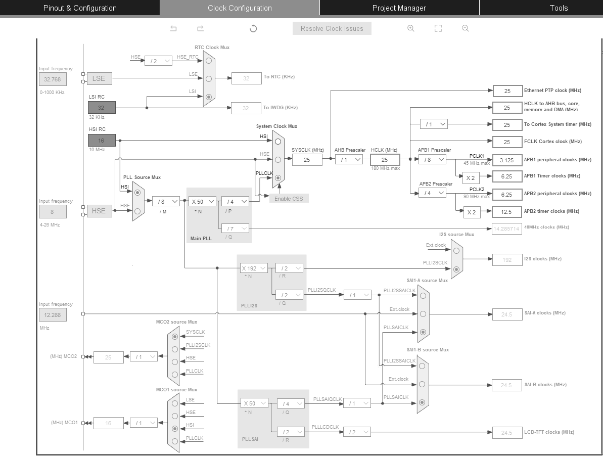
Clock Signals in Embedded Systems
  The STM32F4 microcontroller clock tree

Slide 10

Timers in Embedded Systems
What is a Timer?
A timer is basically a counter such that the count value changes (going up, down, or up and down) by a trigger.
If we pick the trigger to be the rising or falling edge of a periodic clock signal, then the count value changes based on the clock.
This way, we can determine the actual time within our application running on the microcontroller.
  A basic timer module

Slide 11
Timers in Embedded Systems
Introducing Timers in the STM32F4Microcontroller
The STM32F4 microcontroller has four different timer types as
  Base timer: used for general time related operations
  Watchdog timer: used for resetting the CPU when an error halts code execution
  System timer (SysTick): used for general time related operations
  real-time clock (RTC): used for determining the exact date and time.

Slide 12
Timers in Embedded Systems
Base Timers in the STM32F4Microcontroller
There are 14 base timers in the STM32F4 microcontroller.
These are called TIM1, TIM2, · · · , TIM14.
Base timer consists of four blocks as
  trigger and clock controller
  counter
  input capture
  output compare

Slide 13
Timers in Embedded Systems
System Timer in the STM32F4Microcontroller
System timer, also called SysTick, is mainly used by the real-time operating system (RTOS).
It can also be used as a dedicated timer.
Since SysTick is extensively used by RTOS, it is fed by the main system clock.
This clock can be divided by 1 or 8 according to the prescaler selection.
SysTick has a 24-bit down counter to create 1 ms time intervals.

Slide 14
Timers in Embedded Systems
Watchdog Timers in the STM32F4 Microcontroller
A software failure can create an infinite loop and halt code execution within the microcontroller. Resetting the CPU is the best option to recover from such situations.
Watchdog is a special timer which resets the CPU if its counter counts to zero from its initial value (called timeout).
The counter must be reloaded by a code to prevent the reset operation.
If the code cannot be executed until the reload operation, the watchdog timer resets the CPU.
There are two different watchdog timers in the STM32F4 microcontroller as:
  independent watchdog (IWDG)
  window watchdog (WWDG)

Slide 15
Timers in Embedded Systems
Real-time Clock in the STM32F4 Microcontroller
Real-time clock (RTC) is a unique binary coded decimal (BCD) timer which can run independently as long as it is powered properly.
It works even under reset or low-power modes.
It keeps track of the exact time as seconds, minutes, hours (in 12- or 24-hour format), day (day of the week), date (day of the month), month, and year in two 32-bit registers in BCD format.
The sub-seconds is also tracked within the RTC and kept in another register.
Daylight saving compensation can also be configured in RTC through software.
RTC has two programmable alarms with interrupt generation property.
These are called Alarm A and B.
These alarms can be used by enabling and setting a date to them.

